Slide 1

Synopsis Presentation
on
Virtual Assistant for People with Autism
By
Anshika Srivastava 202410116100032
Ankit Kumar 202410116100027
Anik Kushwaha 202410116100026
Session:2025-2026 (III Semester)
Under the supervision of
Prof. Ms Hunny Gaur
Department Of Computer Applications
KIET GROUP OF INSTITUTIONS, DELHI-NCR, GHAZIABAD-201206

Slide 2

AutismHelper: A Digital Support Tool for Autism
Empowering children with autism and their families through intuitive digital solutions.
Problem - Children with autism often struggle with communication, daily routines, and social interaction.
Solution - AutismHelper is a smart digital assistant designed to make learning, communication, and daily life easier for them.

Slide 3
Understanding the World of Autism
Autism is a lifelong condition that affects how individuals communicate, learn, and interact socially. Children with autism often face unique challenges, including:
💬 Communication Hurdles
🗓️ Daily Task Management
👂 Sensory Sensitivities
Difficulty remembering and managing routines and tasks.
Feeling overwhelmed in noisy or busy environments.
Struggling with complex language and expressing emotions clearly.
While support from teachers, parents, and therapists is invaluable, traditional tools like Alexa or Siri aren't tailored to their specific needs. AutismHelper steps in to fill this gap.

Slide 4




Our Vision for AutismHelper
AutismHelper is designed to empower children with autism by providing a supportive and engaging digital environment. Our core objectives are to:
Enhance Communication
Simplify Daily Routines
Help children express their needs and feelings more easily.
Support kids in completing everyday tasks and managing their schedules.
Foster Learning
Build Social Confidence
Offer fun and structured ways to acquire new skills and knowledge.
Improve comfort and participation in social interactions.

Slide 5

Who Benefits? And What It Does!
Who will use AutismHelper?
What will AutismHelper do?
Children with autism: The primary users, gaining independence and skills.
Communication Support: Facilitating easier expression of thoughts and needs.
Parents & Caregivers: A valuable tool for supporting their child's development at home.
Daily Task Assistance: Helping with schedules and routines.
Teachers & Special Education Professionals: An aid for classroom management and individualized learning plans.
Learning & Skill Development: Providing engaging educational content.
Social Interaction Practice: Creating safe spaces for practicing social cues.
Important Note: AutismHelper is a supportive learning tool, not a medical app.

Slide 6




Key Features: Making Life Easier
Talk & Share
My Day Helper
Allows children to express themselves by speaking or typing simple messages. Customizable vocabulary and visual cues help bridge communication gaps, reducing frustration and fostering self-expression.
Visual daily schedules and gentle reminders for tasks like brushing teeth, getting dressed, or homework. Breaks down complex routines into manageable steps, promoting independence and reducing anxiety around transitions.
Learn & Play
Make Friends
Engaging mini-lessons and interactive games focused on social skills, emotional recognition, and cognitive development. Uses positive reinforcement and visual learning to make education fun and effective.
Offers a safe, guided environment to practice conversational skills and understand social scenarios. Provides prompts and feedback to build confidence for real-world interactions.

Slide 7
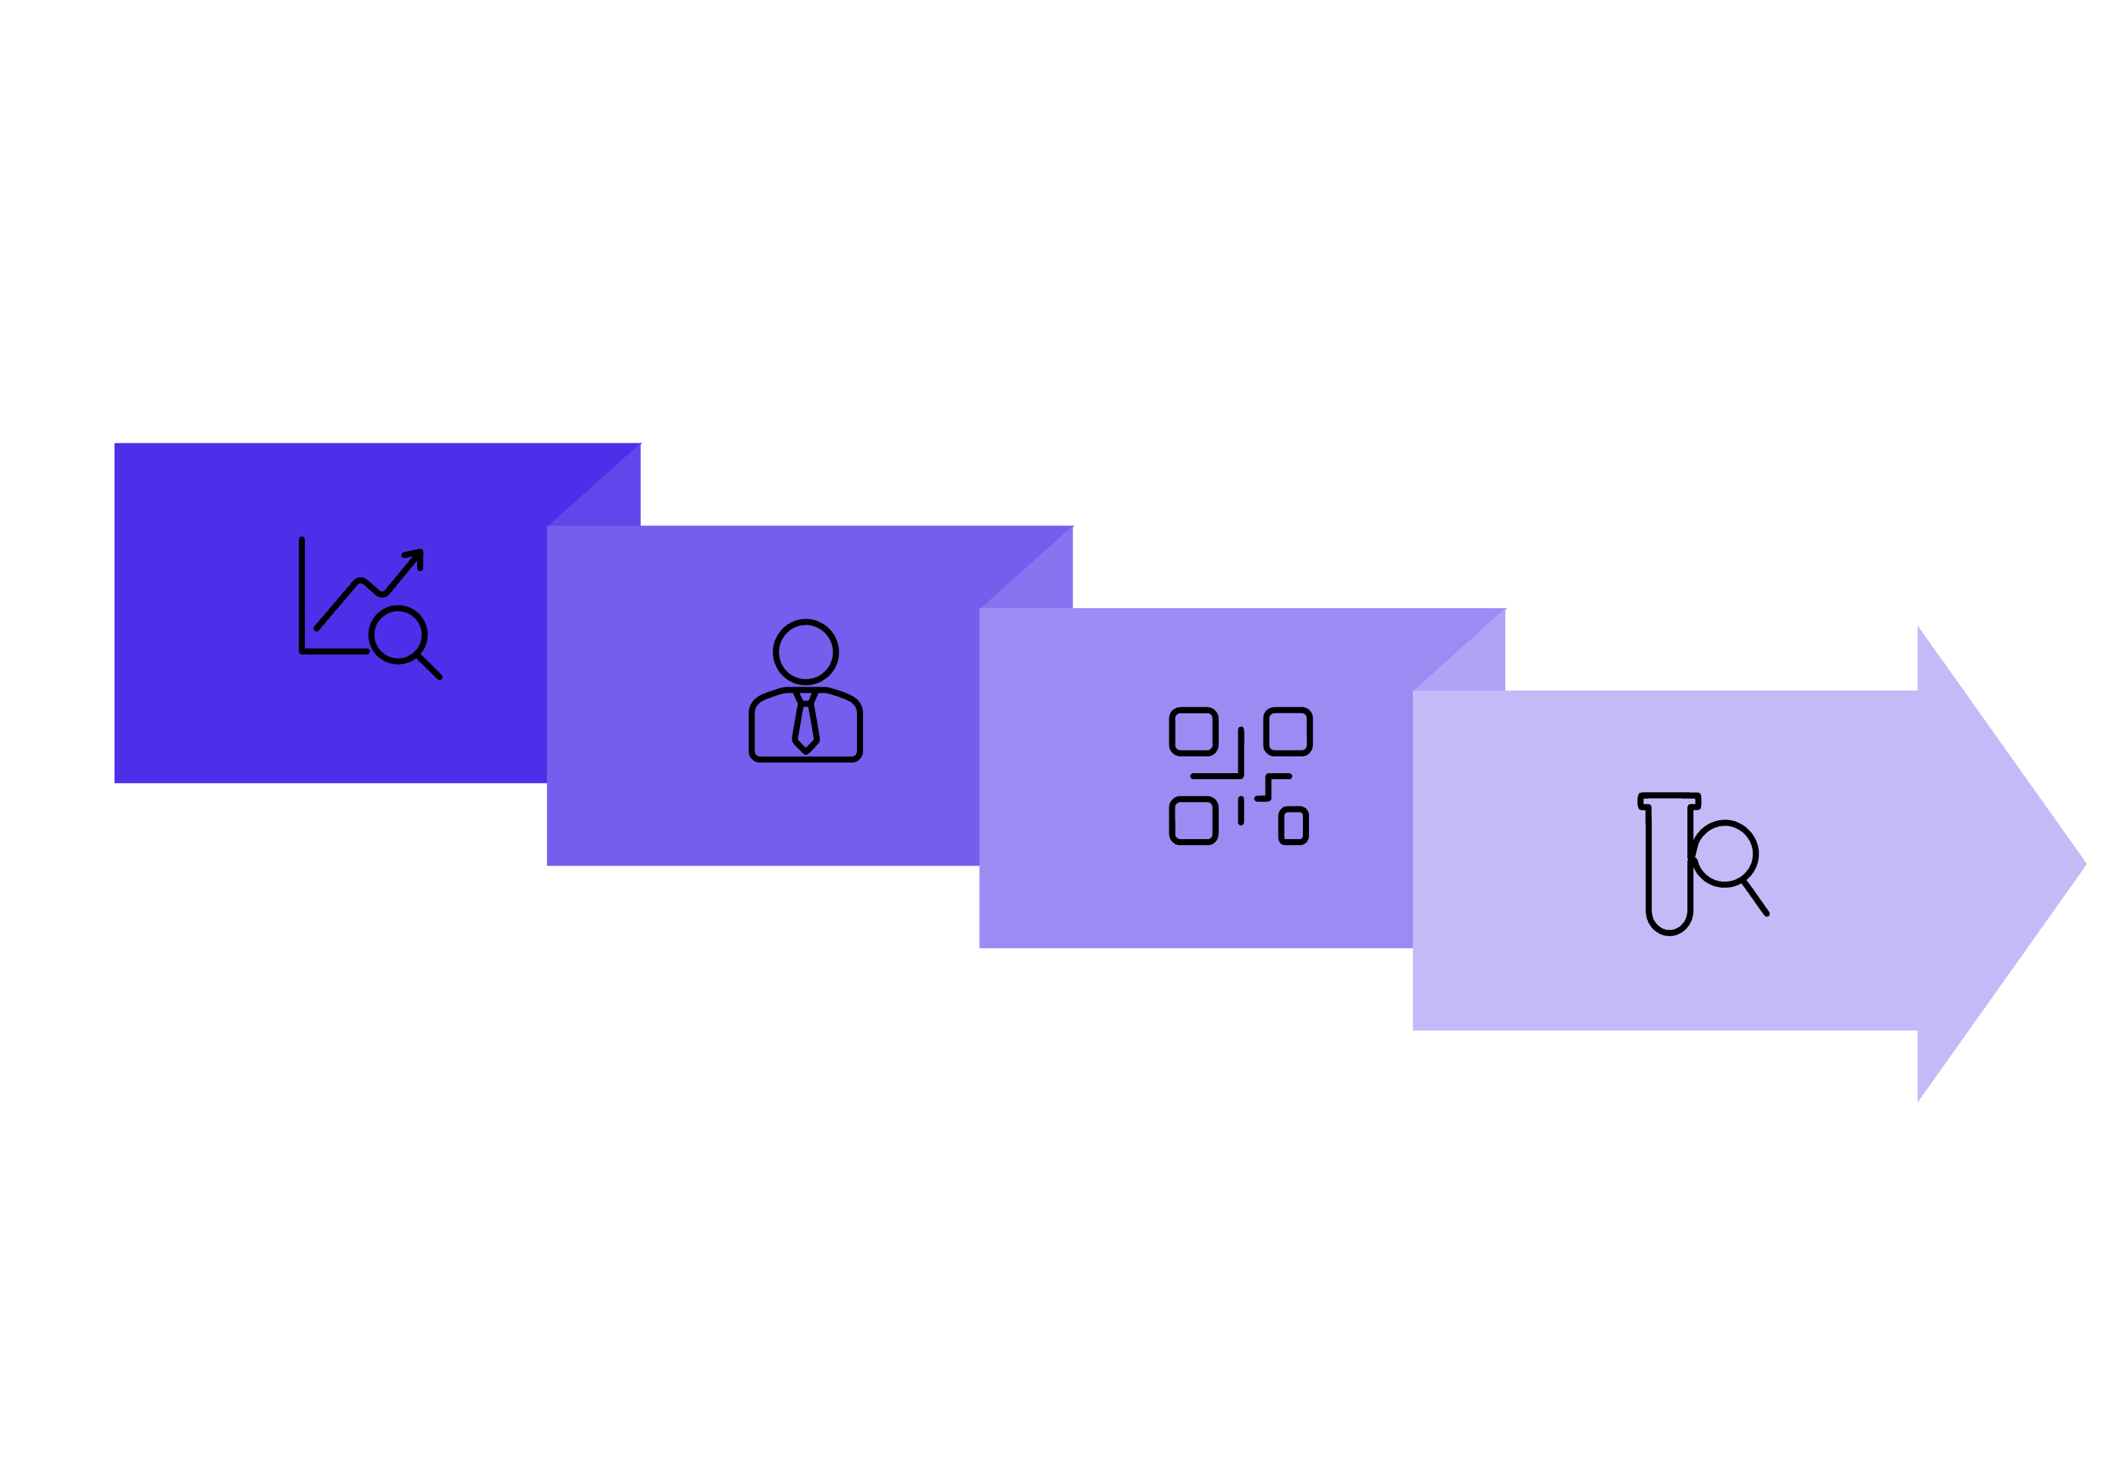
Our Development Journey & Tech Stack
Our approach to building AutismHelper is structured and user-centric, ensuring the tool is effective and easy to use.
Research
Develop
Design
Test
Technology Driving AutismHelper:
We leverage robust and scalable technologies to ensure a seamless and reliable experience:
Frontend
Backend
React (Web) for a smooth,
responsive interface.
Python (Flask) for powerful and flexible data management.

Slide 8
Our 8-Week Launch Plan
We have a focused and agile timeline to bring AutismHelper to your families and classrooms quickly and efficiently.
Weeks 1-2: Research & Planning
1
Deep dive into user needs, define features, and finalize technical architecture.
2
Weeks 3-4: Design & Prototyping
Create intuitive user interfaces and user experience flows.
Weeks 5-6: Core Development
3
Build the main features, ensuring stability and functionality.
4
Week 7: Testing & Refinement
Rigorous testing with target users to identify and fix any issues.
Week 8: Final Launch
5
Release AutismHelper to the public!

Slide 9

"Every child deserves a voice and a chance to grow."
Thank you for believing in AutismHelper – a tool that makes a difference.

